Slide 1
Capstone Project
Unsupervised – ML – Zomato Restaurant Clustering and Sentiment Analysis Team Members Jayanth V Gowthaam Kumarasamy

Slide 2
INDEX
Problem Statement
Data Overview
Zomato Business Model
Pre Processing Data
EDA
Feature Engineering
Vader model (Text Preprocessing)
Clustering
K-Means Clustering
DBSCAN Clustering
Sentiment Analysis
Conclusion

Slide 3
PROBLEM STATEMENT
Zomato is an Indian restaurant aggregator and food delivery start-up founded by Deepinder Goyal and Pankaj Chaddah in 2008. Zomato provides information, menus, and user reviews of restaurants, and also has food delivery options from partner restaurants in select cities.
The Project focuses on Customers and companies, We have to analyze the sentiments of the reviews given by the customer in the data and made some useful conclusions in the form of Visualizations. Also, cluster the zomato restaurants into different segments. The data is visualized as it becomes easy to analyze data in an instant. The Analysis also solve some of the business cases that can directly help the customers find the Best restaurant in their locality and for the company to grow up and work in the fields they are currently lagging in.

Slide 4
DATA OVERVIEW
We have been given two datasets to work with, a metadata dataset and a review dataset. Analyzing both the datasets we have columns such as.
Name - Name of the Restaurants.
Links - Links of the Restaurants
Cost - Average cost of the meal in Restaurants.
Collections - The Collections in Zomato features popular restaurants across specific themes and trends at a particular location.
Cuisines - A cuisine is specific set of cooking traditions and practices, often associated with a specific culture or region.
Timing - Opening and closing time of the Restaurants.
Restaurant - Name of the Restaurants.
Reviewer - Name of the Reviewer.
Review - Experience of the reviewer in the restaurant expressed in words.

Slide 5
DATA OVERVIEW
Rating - Experience of the reviewer in the restaurant expressed in numbers.
Metadata – A set of data that describes and gives information about reviewers.
Time – The time at which the reviews and ratings are given.
Pictures – Number of pictures taken by the reviewer.

Slide 6
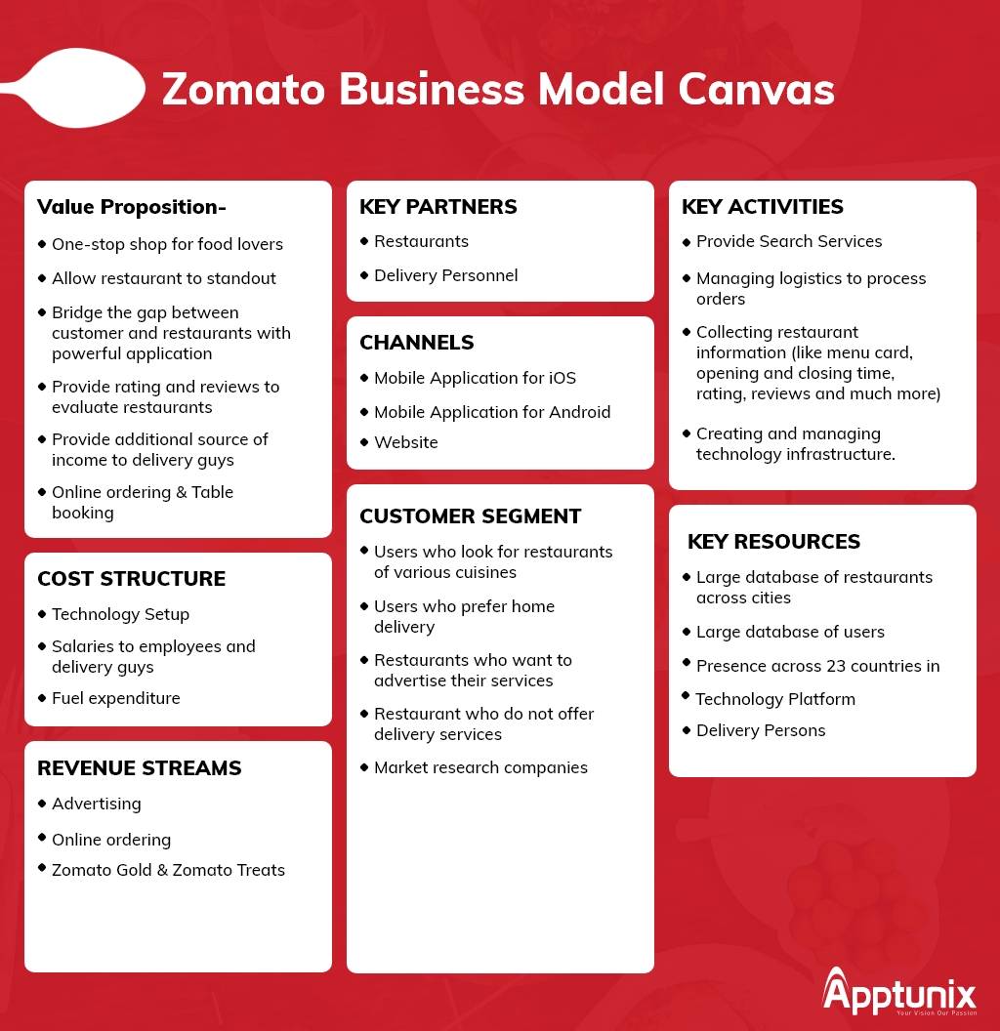
Zomato Business Model
Zomato’s Business Model is aimed at
providing quality food services,
information related to restaurants,
their menus and user reviews. The
The business model of Zomato consists
of providing food delivery services,
information, user reviews, and menus
of partner restaurants. It has created a
revolution in industries doing food
business by including different
restaurants and facilitating people to
look for restaurants more conveniently.

Slide 7
PRE PROCESSING DATA
While processing the data we tend to :
In the metadata dataset, the collection feature contains more than 50% of null values, so we are dropping the collections feature.
Remove some columns if not necessary for our analysis.

Slide 8
EXPLORATORY DATA ANALYSIS

Slide 9
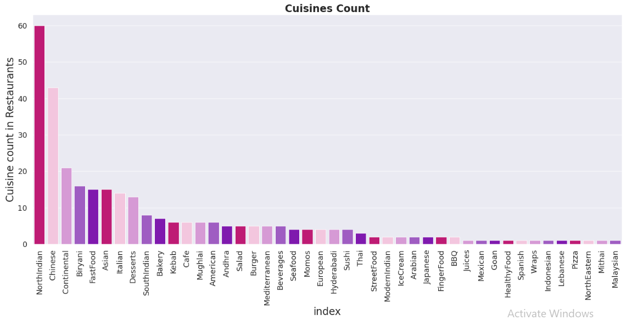
The metadata dataset is displayed below in the form of a bar graph.

Slide 10
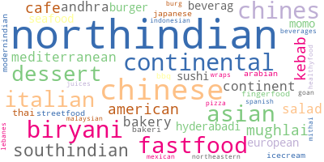
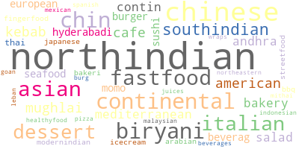
EDA (continue… )
Visualization of words from 'Cuisines' feature

Slide 11
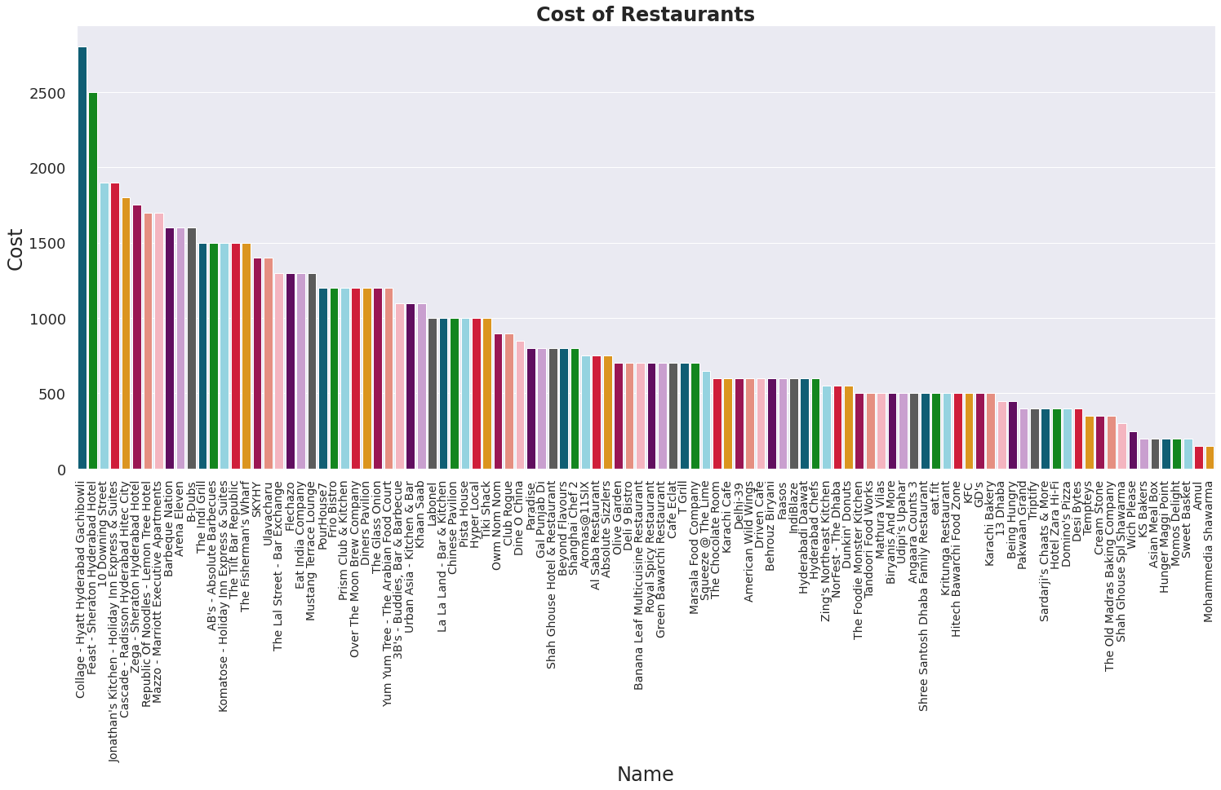
EDA (continue… )
Visualization of Restaurant names and their respective cost

Slide 12
Text Preprocessing
We process the texts in specific columns for our model implementation. The process includes [ Removing non-ASCII words
Convert all words to lowercase, Remove punctuation Replace numbers, Stem words, Lemmatize verbs, and normalize Words
]

Slide 13
Text Preprocessing (continued… )
TFIDF vectorizer
Term frequency-inverse document frequency is a text vectorizer that transforms the text into a usable vector. It combines 2 concepts, Term Frequency (TF) and Document Frequency (DF). The term frequency is the number of occurrences of a specific term in a document. This will help us convert our words into numerical values for implementing our values.

Slide 14
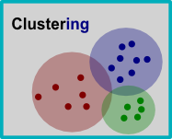
Clustering
Cluster analysis or clustering is the task of grouping a set of objects in such a way that objects in the same group (called a cluster) are more similar (in some sense) to each other than to those in other groups (clusters).

Slide 15
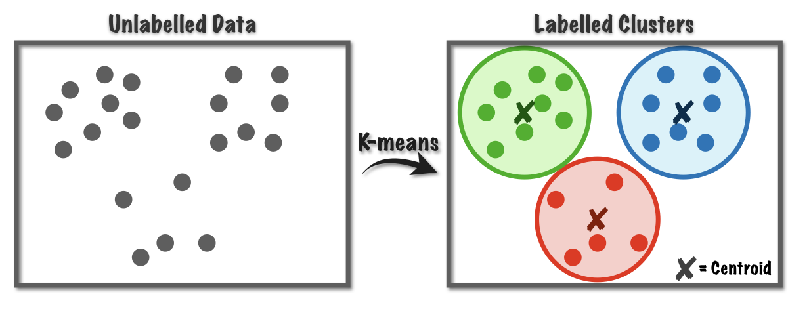
Clustering (continued)
On Zomato Restaurant Names and Metadata dataset. K Means Clustering
The K-means clustering algorithm computes centroids and repeats until the optimal centroid is found. It is presumptively known how many clusters there are. It is also known as the flat clustering algorithm. The number of clusters found from data by the method is denoted by the letter ‘K’ in K-means.

Slide 16
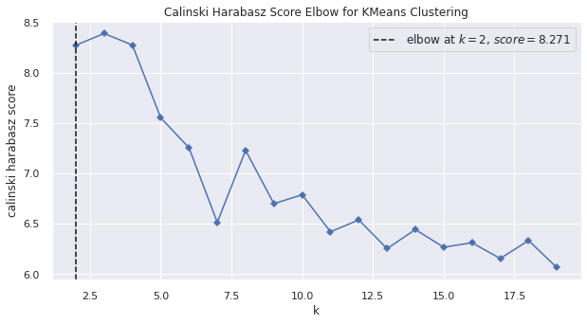
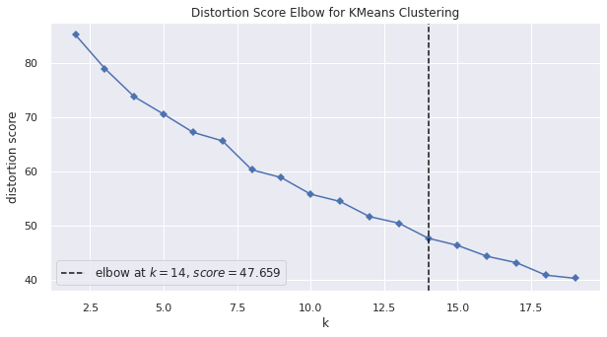
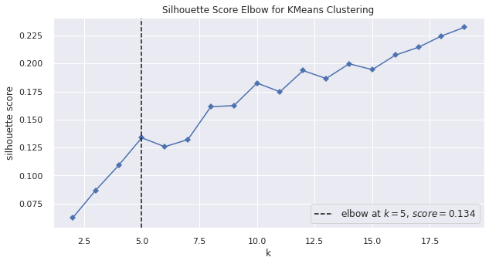
Clustering (continued)
In order to find the appropriate k – value we tend to implement the elbow method The average silhouette score for k means
Is considered as 14 in our case.

Slide 17
Clustering (continued)
On Zomato Restaurant Names and Metadata dataset.
Working of K-Means Algorithm
The following stages will help us understand how the K-Means clustering technique works-
Step 1: First, we need to provide the number of clusters, K, that need to be generated by this algorithm.
Step 2: Next, choose K data points at random and assign each to a cluster. Briefly, categorize the data based on the number of data points.
Step 3: The cluster centroids will now be computed.
Step 4: Iterate the steps below until we find the ideal centroid, which is the assigning of data points to clusters that do not vary.

Slide 18
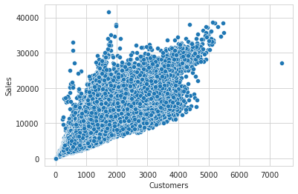
The scatter plot is put up to show the effect that the customers have on the sales.

Slide 19
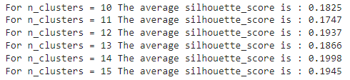
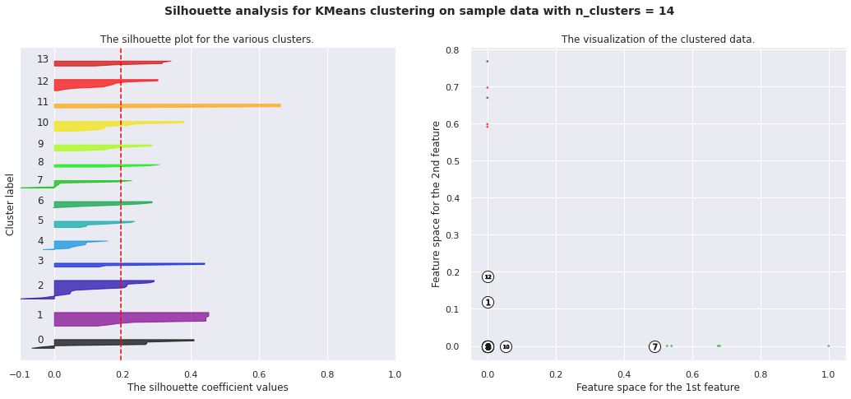
Clustering (continued)
The average scores of all cluster implementation is shown. among them
the cluster value is set as 14 so that we get an increased silhouette score of
0.1998

Slide 20
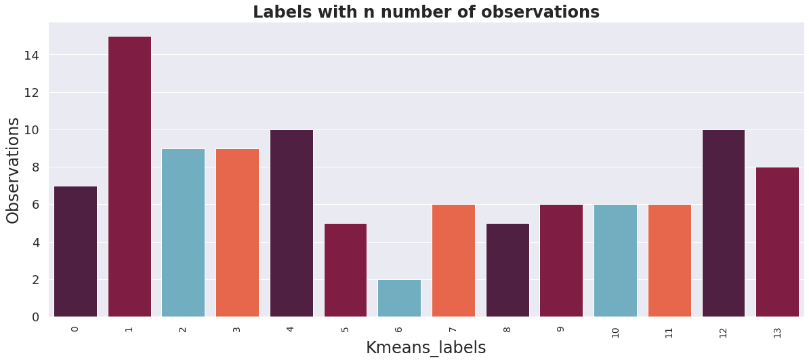
Clustering (continued)
K Means Clustering

Slide 21
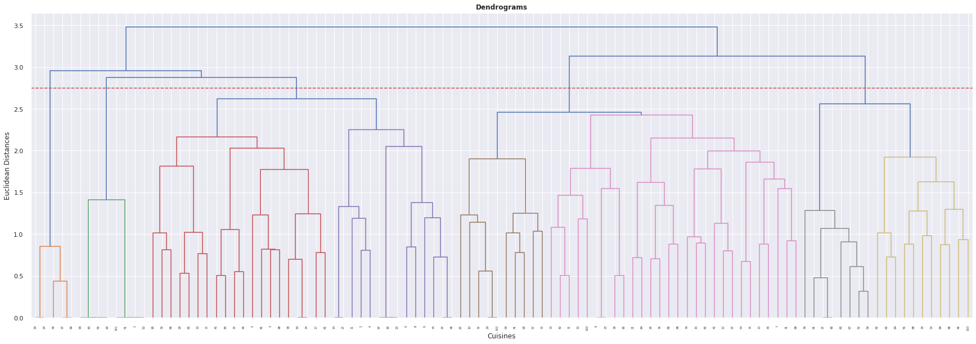
Clustering (continued)
HIERARCHICAL CLUSTERING
Hierarchical clustering is another unsupervised machine learning algorithm, which is used to group the unlabeled datasets into a cluster and is also known as hierarchical cluster analysis or HCA.
In this algorithm, we develop the hierarchy of clusters in the form of a tree, and this tree-shaped structure is known as the dendrogram.

Slide 22
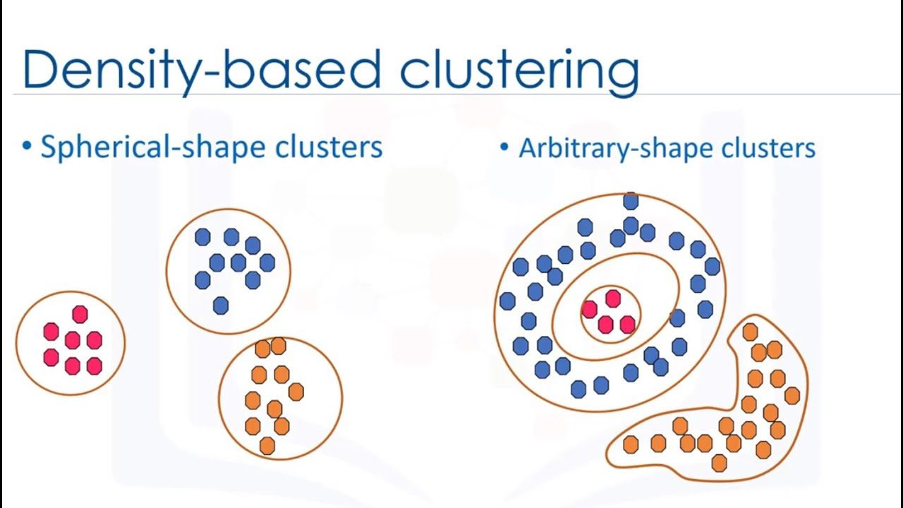
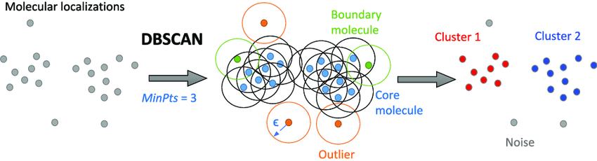
Clustering (continued)
DBSCAN Clustering
DBSCAN is a density-based clustering algorithm that works on the assumption that clusters are dense regions in space separated by regions of lower density. It groups ‘densely grouped’ data points into a single cluster. It can identify clusters in large spatial datasets by looking at the local density of the data points. The most exciting feature of DBSCAN clustering is that it is robust to outliers.

Slide 23
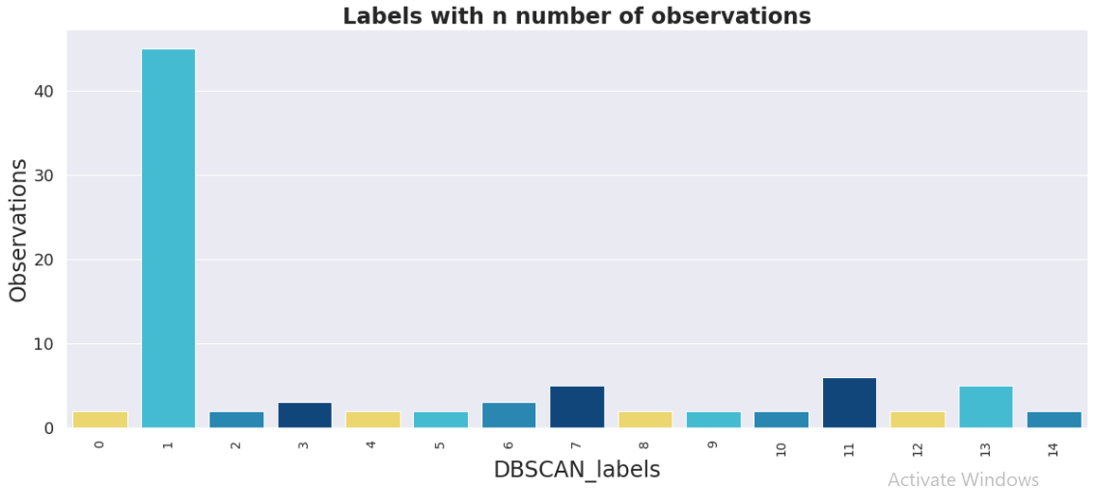
Clustering (continued)
DBSCAN Clustering

Slide 24
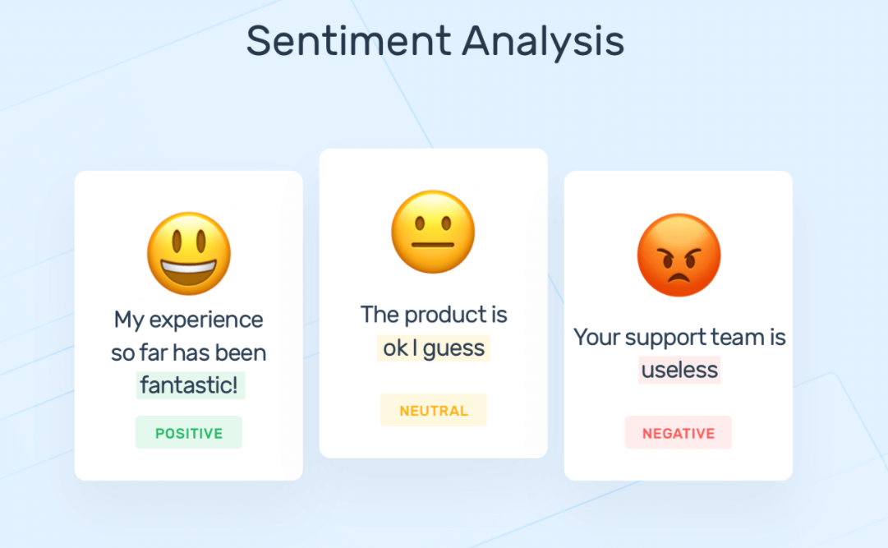
Sentiment Analysis
Vader Model
Sentiment analysis is a text analysis method that detects polarity (e.g. a positive or negative opinion) within the text, whether a whole document, paragraph, sentence, or clause. Sentiment analysis aims to measure the attitude, sentiments, evaluations, attitudes, and emotions of a speaker/writer based on the computational treatment of subjectivity in a text.

Slide 25
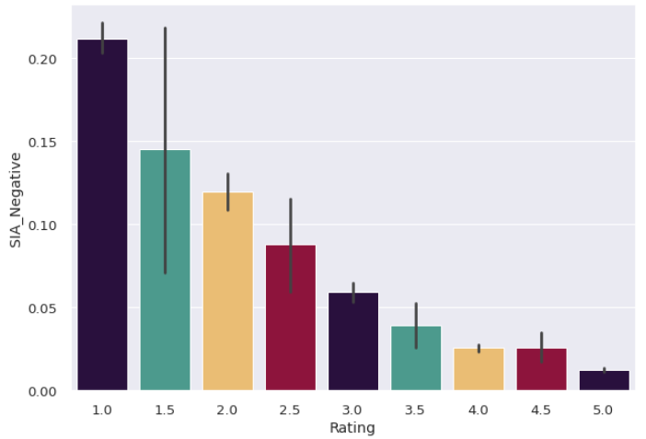
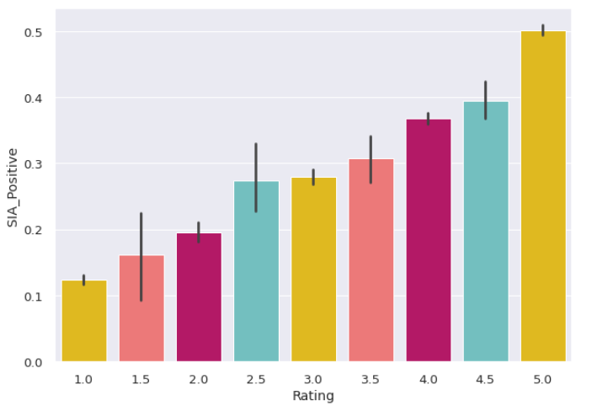
Sentiment Analysis (continued)
Considering the rating given by all the customers, They are been spit into negative and positive ones by analysing the sentiments in their review and displaying them in the form of graph’s

Slide 26
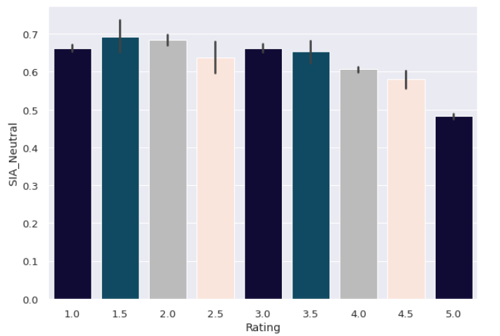
Sentiment Analysis (continued)

Slide 27
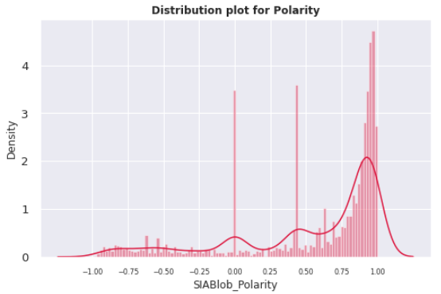
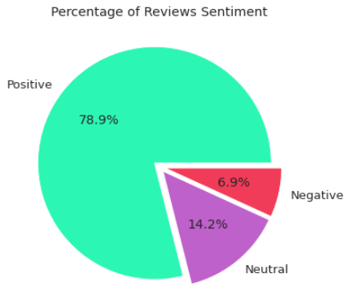
Sentiment Analysis (continued)
Vader Model distribution.

Slide 28
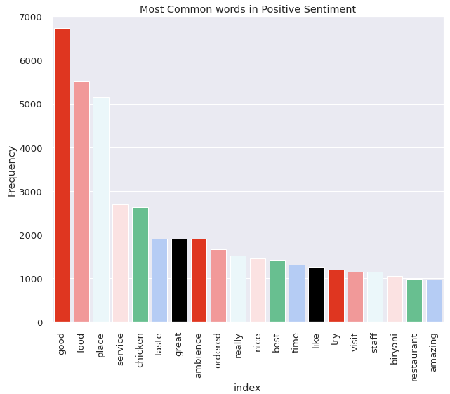
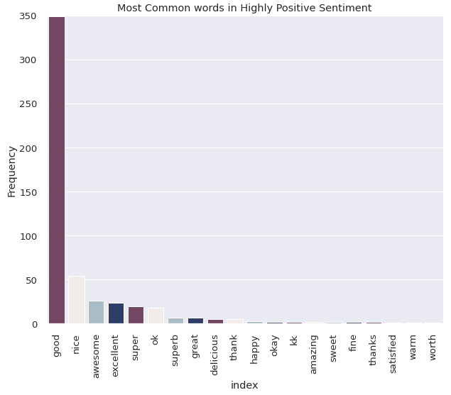
Sentiment Analysis (continued)

Slide 29
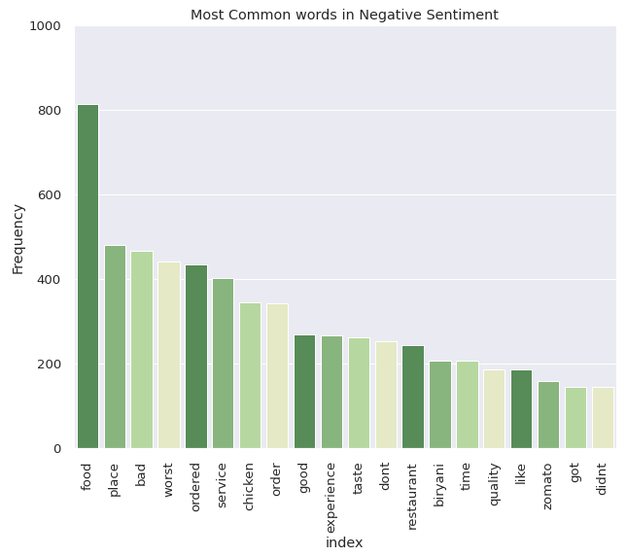
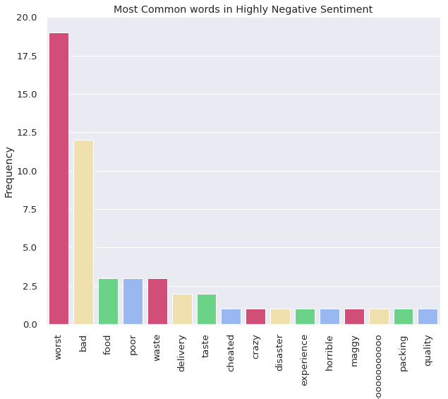
Sentiment Analysis (continued)
Vader Model.

Slide 30
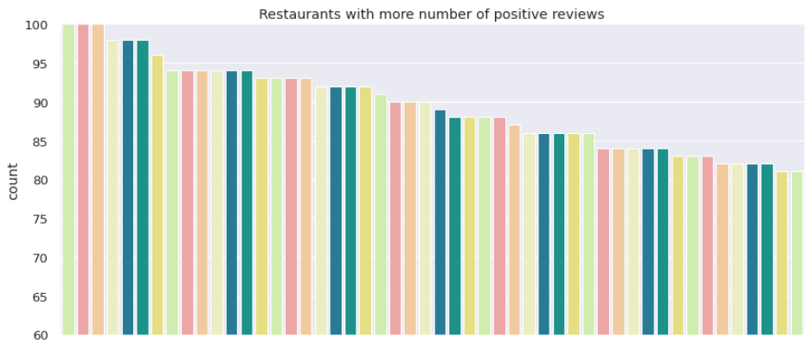
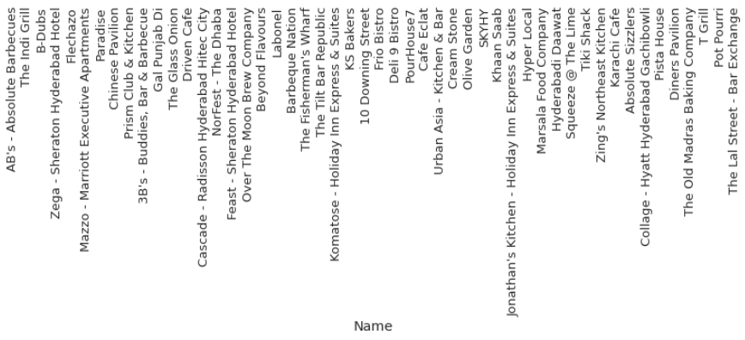
Sentiment Analysis (continued)

Slide 31
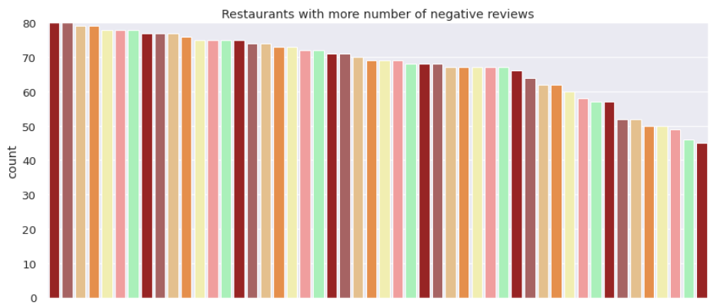
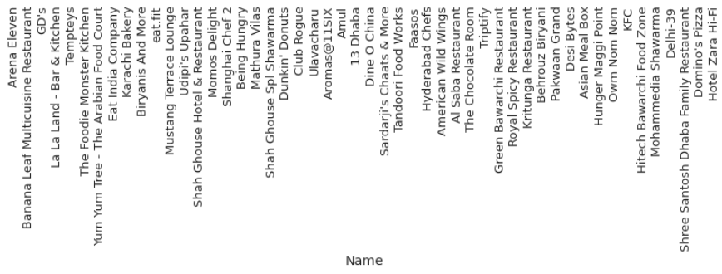
Sentiment Analysis (continued)

Slide 32
Conclusion
North Indian cuisine is the most common cuisine found in restaurants.
Collage - Hyatt Hyderabad Gachibowli is the most expensive restaurant.
Amul and Mohammedia Shawarma are the most affordable restaurants.
The Restaurants are clustered on cuisines into 14 clusters by using KMeans clustering algorithm with the Silhouette score of 0.195.
DBSCAN algorithm is used to cluster the restaurants into 14 clusters and also helps us to detect the outlier observations with the Silhouette score of 0.107
Anvesh Chowdary has given more reviews.
AB's - Absolute Barbecues is the top-rated restaurant.
Almost 79 percent of the observations have positive sentiment and 14 and 7 percent of the observations have Neutral and Negative sentiments respectively.
Good is the most common word in the highly positive sentiment.
Worst is the most common word in the highly negative sentiment.
AB’s – Absolute Barbecues, The Indi Grill, and B- Dubes are the restaurants with more number of positive reviews.
Arena Eleven and Banana Leaf Multicuisine are the restaurants with more number of negative reviews

Slide 33
Conclusion
Udipi's Upahar is the most affordable restaurant with the best rating.
Feast - Sheraton Hyderabad Hotel is the most expensive restaurant with the best rating.
Asian Meal Box is the most affordable restaurant with the worst rating.
Club Rogue is the expensive restaurant with worst rating

Slide 34
Thank you

